Slide 1



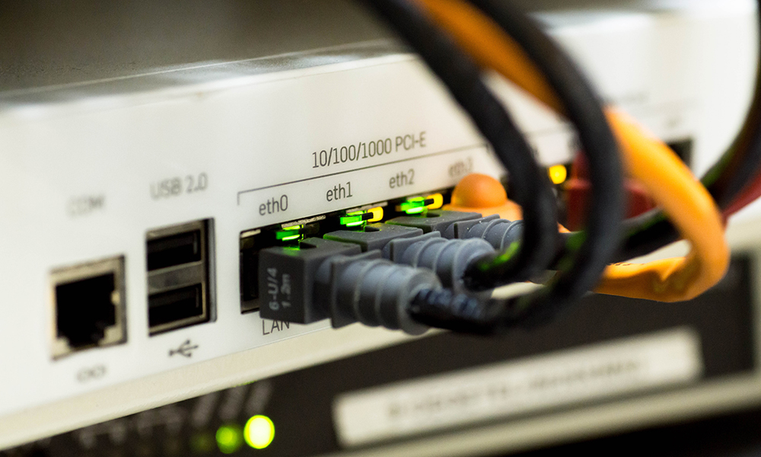

CSC 1010 Networks & Internet
Dr. Mohammed Amine TOGOU
Module Description
1

Slide 2
Contact info
Assistant Professor - School of Computing
Office L2.50 (Second floor)
Email: mohammedamine.togou@dcu.ie
Phone: (01) 700 8929
Email in advance for appointment!
2
CSC1010: Networks & Internet | Module information

Slide 3
Course structure
Lectures: Mondays from 3 to 5pm in SA301
Assessment
Continuous assessment: 50%
Assignments: 15% (Weeks 3 and 6)
Don’t inform me at the last minute in case of problems. I won’t be able to help you.
Quiz: 10% (Week 9)
Project: 25% (Week 11)
Exam: 50%
3
CSC1010: Networks & Internet | Module information

Slide 4
Packet Tracer
To complete the assignments and the project, you will need to install Cisco Packet Tracer.
To do so, follow these steps:
Create an account on the platform: www.netacad.com using your DCU email
Once your account is set up, use the search bar at the top and type in Cisco Packet Tracer Resources.
When it appears in the results, select it and click Download to get the tool
4
CSC1010: Networks & Internet | Module information

Slide 5

A note about attendance
There are a lot of you !
Head of School
Me
5
CSC1010: Networks & Internet | Module information

Slide 6
A few directions…
Lecture sessions are a 2-way street
There are no stupid questions
You can ask questions during lectures or send me an email with the following subject:
[CSC1010] <your inquiry>
In case of a problem, contact me ASAP
6
CSC1010: Networks & Internet | Module information

Slide 7
Topics we’ll cover in CSC 1010
Layered network architectures
Network Devices
Communications Protocols
Local area networks
Internet Protocols
IP addressing
Data encoding
Network Tools
The Web
7
CSC1010: Networks & Internet | Module information

Slide 8
Textbooks
Tonnes of Internet resources available
If you do want a textbook
Computer networks by Andrew S Tanenbaum
Computer networking: A top-down approach by Kurose & Ross
8
CSC1010: Networks & Internet | Module information

Slide 9


THANK YOU
CSC1010: Networks & Internet | Module information

